Slide 1

Project Title - Keystroke Logging
Student Name: Thatikonda Arjun
AICTE ID: STU68edc85df2a941760413789
College Name – GITAM University

Slide 2

PROBLEM STATEMENT
This project focuses on developing a simple and lightweight Python-based keystroke logger to monitor keyboard activity for educational and controlled use. It records keystrokes in both plain text and structured JSON formats while providing an easy-to-use GUI interface. The aim is to offer a more accessible and organized alternative to complex existing tools.

Slide 3
Project Description
This project is a Python-based Keystroke Logger built using tkinter for the GUI, pynput for keyboard event listening, and json for structured data storage. When the user clicks "Start Keylogger," the application begins listening to all keyboard events — detecting when a key is Pressed, Held, or Released. All keystrokes are simultaneously saved to two output files: logs.txt (plain text) and logs.json (structured JSON). The application runs on Windows and is designed for educational and monitoring purposes.

Slide 4

WHO ARE THE END USERS?
Parents – To monitor children's keyboard activity and ensure online safety
Employers / IT Administrators – To track employee activity on company-owned systems
Cybersecurity Students & Researchers – To understand how keyloggers work for ethical hacking and defensive security education
Forensic Analysts – To retrieve keystroke evidence during digital investigations
System Administrators – To audit and troubleshoot user behavior on monitored systems

Slide 5

Technology Used
Component | Technology
Programming Language | Python 3
GUI Framework | Tkinter
Keyboard Listener | Pynput library
Data Storage | JSON (logs.json) + Plain Text (logs.txt)
IDE | Python IDLE
OS Platform | Windows

Slide 6
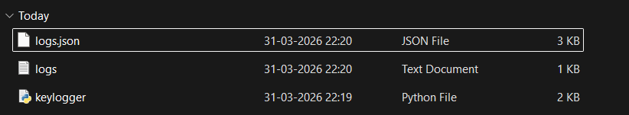
RESULTS
Demo Link

Slide 7
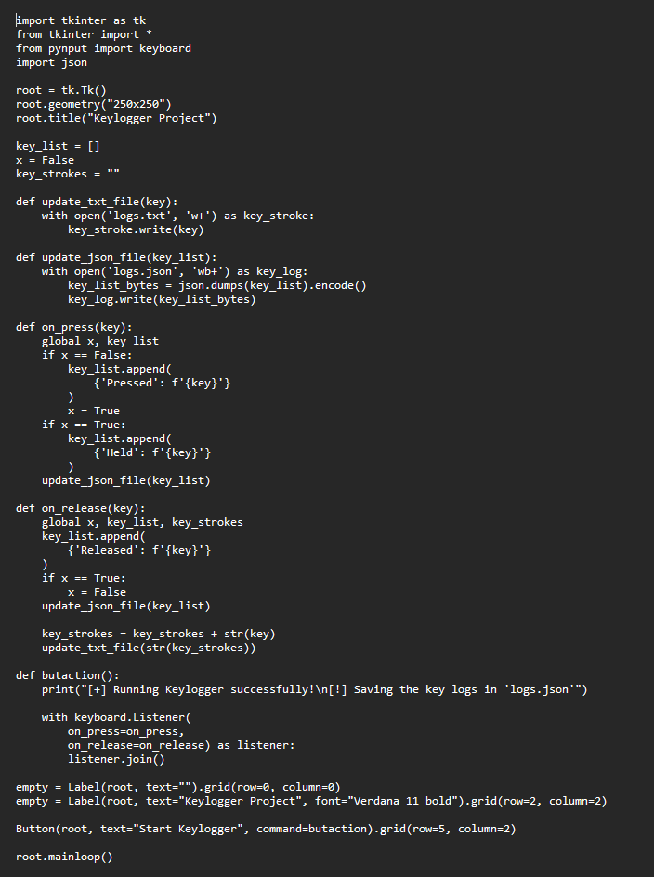
RESULTS
CODE
Demo Link

Slide 8
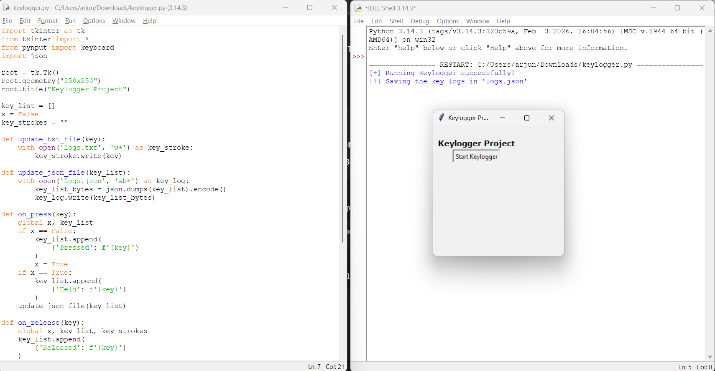
RESULTS
Demo Link

Slide 9
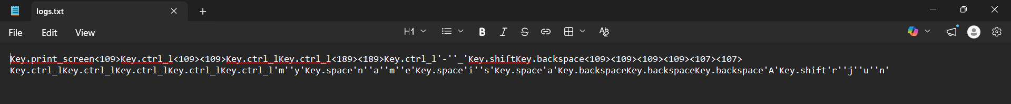
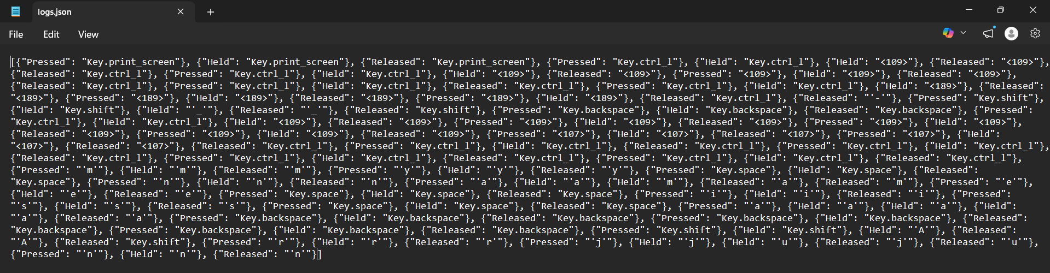
RESULTS
OUTPUT
Demo Link

Slide 10
Thank you
.
.

